Slide 1
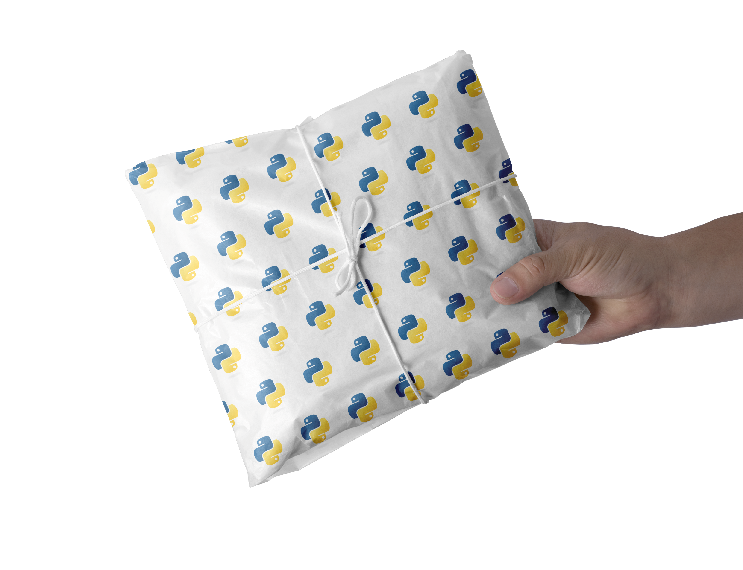

The Python packaging ecosystem
– Simple guidelines for packaging
PyCon Sweden
2023-11-09
Yngve Mardal Moe

Slide 2




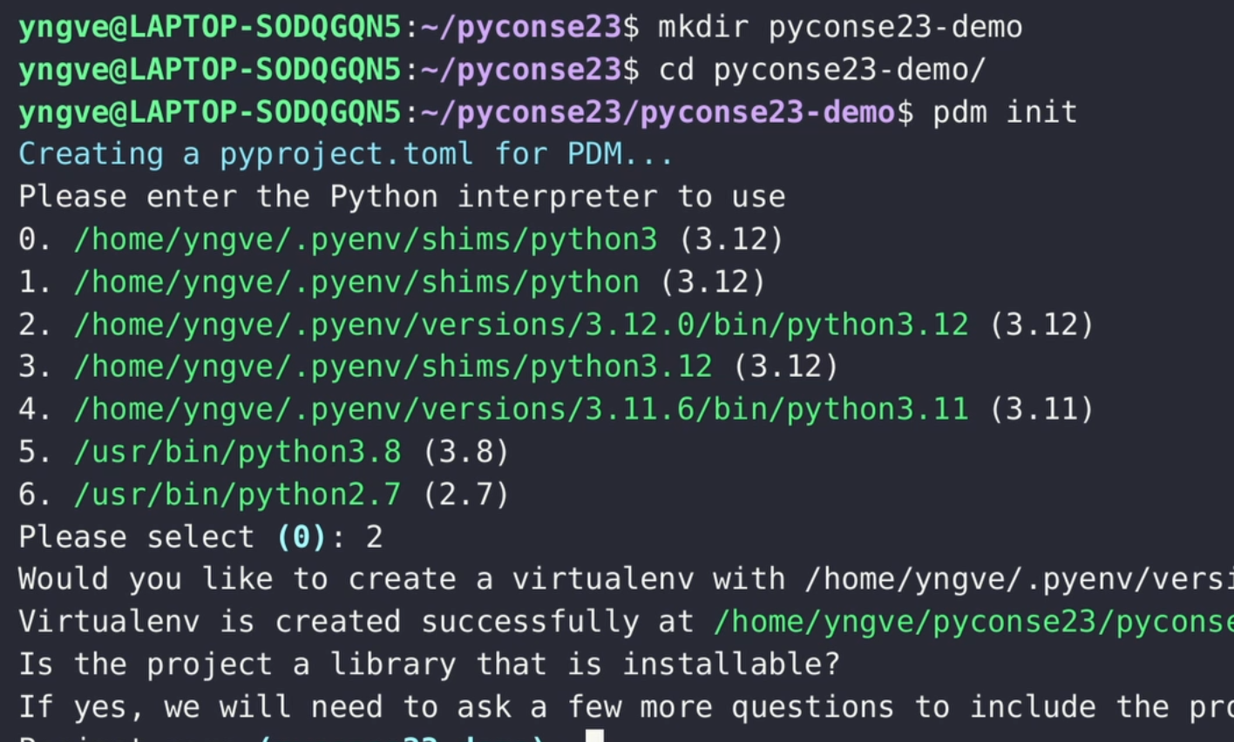
Introduction and brief overview of packaging
✅
Comparison of packaging tools
✅
✅
“Live”
demo

Slide 3
Introduction and brief overview of packaging
✅
Comparison of packaging tools
✅
✅
“Live”
demo

Slide 4






Packaging is about preparing your code to be shared with others
my cool
Python code

Slide 5
The easiest way to package your python project is to bundle it with a list of software requirements
├── my_cool_project
│ ├── __init__.py
│ ├── main.py
│ └── utils.py
└── requirements.txt
my cool
Python code
what
you
need to install

Slide 6

We want to make our code installable by package managers like pip or conda
pip

Slide 7
pip and conda are designed to solve different problems
pip
Install python packages
and python dependencies

Slide 8
pip and conda are designed to solve different problems
pip
Install python packages
and python dependencies
Install general dependencies including non-python
packages, system dependencies and applications

Slide 9


pip and conda are designed to solve different problems
Install general dependencies including non-python
packages, system dependencies and applications

Slide 10

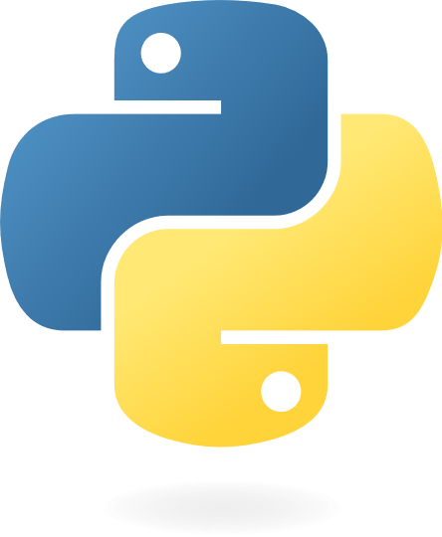
pip and conda are designed to solve different problems
Install general dependencies including non-python
packages, system dependencies and applications

Slide 11

pip and conda are designed to solve different problems
Install general dependencies including non-python
packages, system dependencies and applications

Slide 12
Since pip has a smaller scope, it is also easier to understand how it works
$ pip install litestar

Slide 13
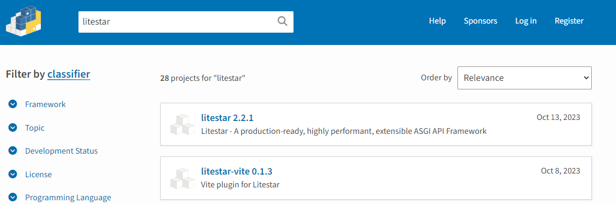
Pip starts by searching PyPI for available packages
$ pip install litestar
Collecting litestar

Slide 14
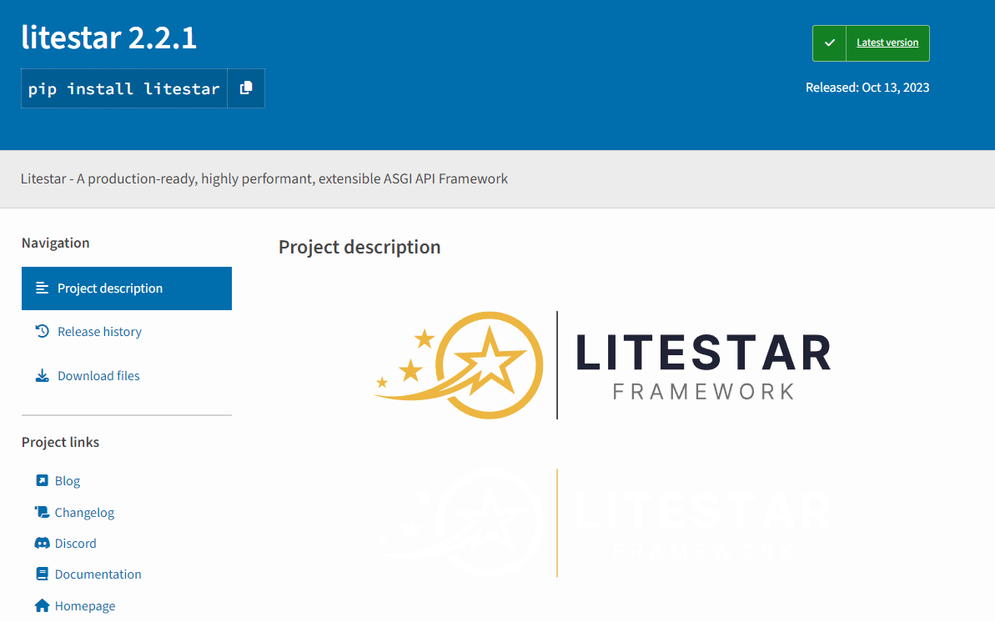
Once pip finds a suitable package, it downloads the package metadata
$ pip install litestar
Collecting litestar
Downloading litestar-2.2.1-py3-none-any.whl.metadata (82 kB)
━━━━━━━━━━━━━━━━━━━━━━━━━━━━━━━━━━━━ 82.7/82.7 kB 1.2 MB/s eta 0:00:00

Slide 15
Then, pip installs the required dependencies
$ pip install litestar
Collecting litestar
Downloading litestar-2.2.1-py3-none-any.whl.metadata (82 kB)
━━━━━━━━━━━━━━━━━━━━━━━━━━━━━━━━━━━━ 82.7/82.7 kB 1.2 MB/s eta 0:00:00
Requirement already satisfied: anyio>=3 in /home/yngve/.pyenv/versions/3.12.0/lib/python3.12/site-packages
[…]

Slide 16
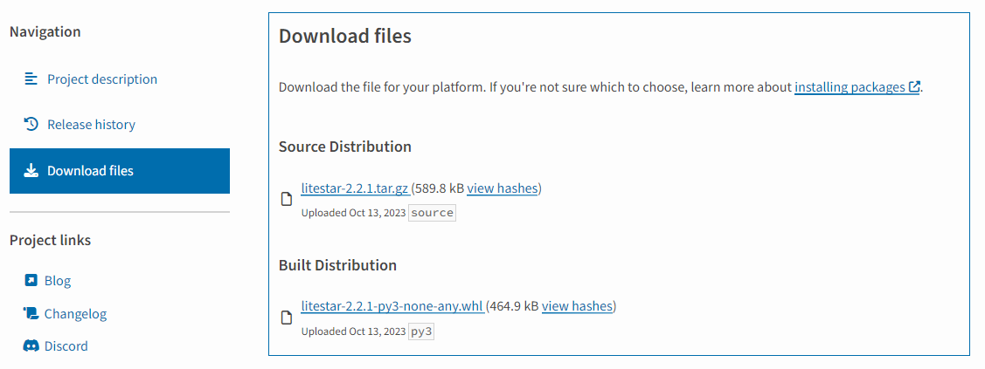
Once all dependencies are installed, pip downloads the package itself
$ pip install litestar
Collecting litestar
Downloading litestar-2.2.1-py3-none-any.whl.metadata (82 kB)
━━━━━━━━━━━━━━━━━━━━━━━━━━━━━━━━━━━━ 82.7/82.7 kB 1.2 MB/s eta 0:00:00
Requirement already satisfied: anyio>=3 in /home/yngve/.pyenv/versions/3.12.0/lib/python3.12/site-packages
[…]
Downloading litestar-2.2.1-py3-none-any.whl (474 kB)
━━━━━━━━━━━━━━━━━━━━━━━━━━━━━━━━━━━━ 474.8/474.8 kB 4.2 MB/s eta 0:00:00

Slide 17
Finally, pip extracts the wheel file to the site-packages directory
$ pip install litestar
Collecting litestar
Downloading litestar-2.2.1-py3-none-any.whl.metadata (82 kB)
━━━━━━━━━━━━━━━━━━━━━━━━━━━━━━━━━━━━ 82.7/82.7 kB 1.2 MB/s eta 0:00:00
Requirement already satisfied: anyio>=3 in /home/yngve/.pyenv/versions/3.12.0/lib/python3.12/site-packages
[…]
Downloading litestar-2.2.1-py3-none-any.whl (474 kB)
━━━━━━━━━━━━━━━━━━━━━━━━━━━━━━━━━━━━ 474.8/474.8 kB 4.2 MB/s eta 0:00:00
Installing collected packages: litestar
Successfully installed litestar-2.2.1
Extract to
python-3.11.3/Lib/site-packages

Slide 18
An important question is how we create wheels and source distributions
$ pip install litestar
Collecting litestar
Downloading litestar-2.2.1-py3-none-any.whl.metadata (82 kB)
━━━━━━━━━━━━━━━━━━━━━━━━━━━━━━━━━━━━ 82.7/82.7 kB 1.2 MB/s eta 0:00:00
Requirement already satisfied: anyio>=3 in /home/yngve/.pyenv/versions/3.12.0/lib/python3.12/site-packages
[…]
Downloading litestar-2.2.1-py3-none-any.whl (474 kB)
━━━━━━━━━━━━━━━━━━━━━━━━━━━━━━━━━━━━ 474.8/474.8 kB 4.2 MB/s eta 0:00:00
Installing collected packages: litestar
Successfully installed litestar-2.2.1
How do we make these?
Extract to
python-3.11.3/Lib/site-packages

Slide 19
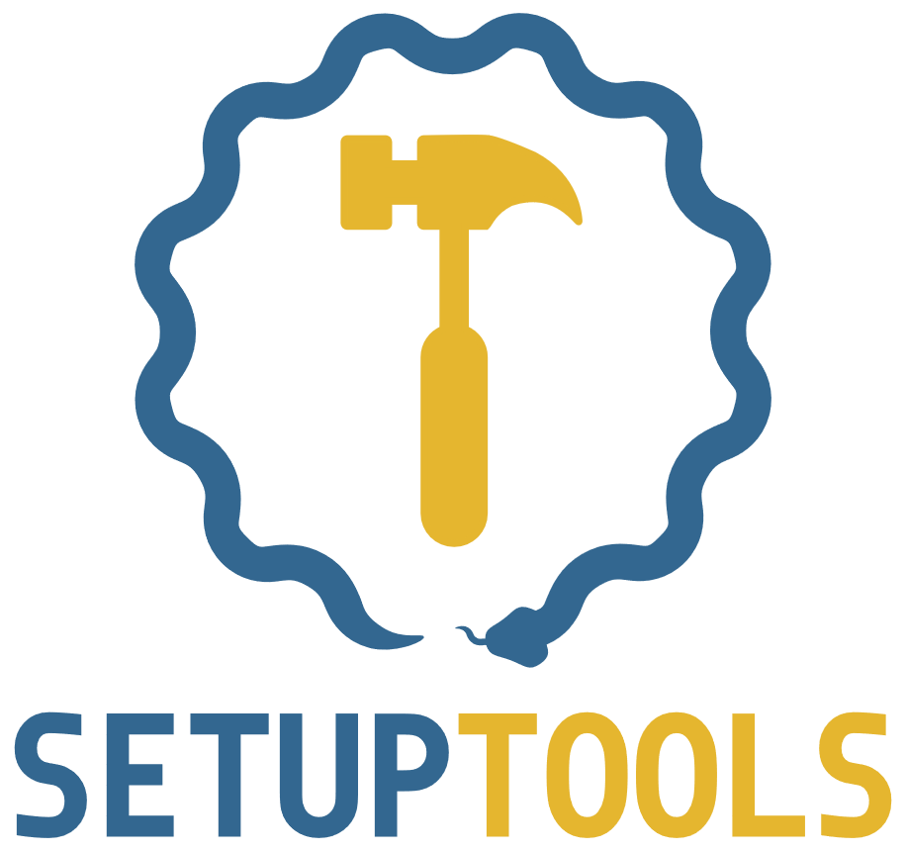
Setuptools is an old and powerful packaging tool
Complicated
Few features
Many features
Simple

Slide 20

Flit makes it very easy to package and distribute pure python packages
Complicated
Few features
Many features
Simple

Slide 21

Poetry is an easy-to-use project manager and packaging tool with many useful features
Complicated
Few features
Many features
Poetry
Simple

Slide 22
PEP 621 specifies how project metadata should be specified in a pyproject.toml file
[project]
name = "spam"
version = "2020.0.0"
description = "Lovely Spam! Wonderful Spam!"
readme = "README.rst"
requires-python = ">=3.8"
authors = [
{name = "Pradyun Gedam", email = "pradyun@example.com"},
]
dependencies = [
"httpx",
"django>2.1; os_name != 'nt'",
"django>2.0; os_name == 'nt'",
]
...

Slide 23
PEP 517 and 518 specifies a package should be built
[build-system]
# Defined by PEP 518:
requires = ["flit_core >=3.2,<4“]
# Defined by PEP-517:
build-backend = "flit_core.buildapi"
We need flit to build this project
We use this entry-point to build the package

Slide 24
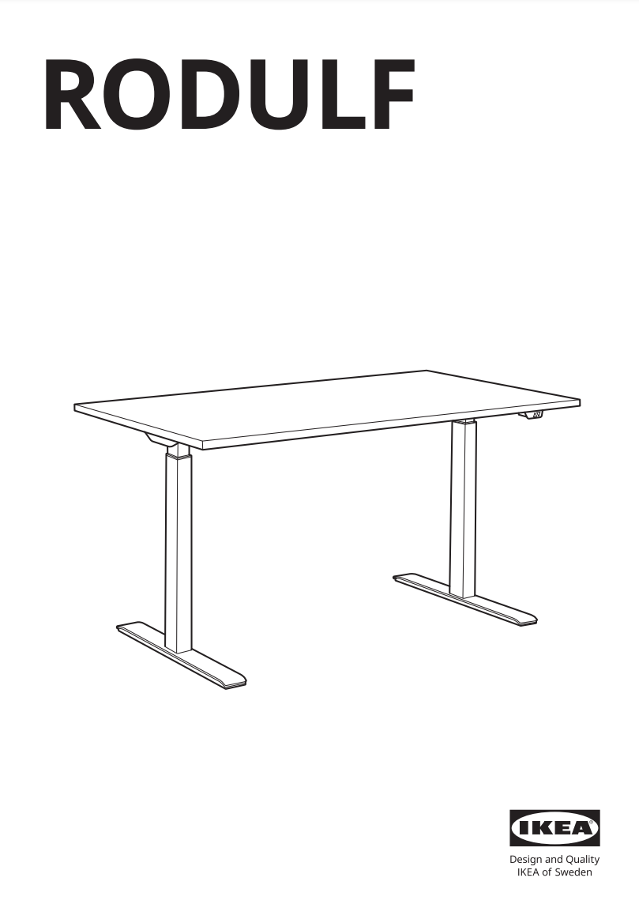
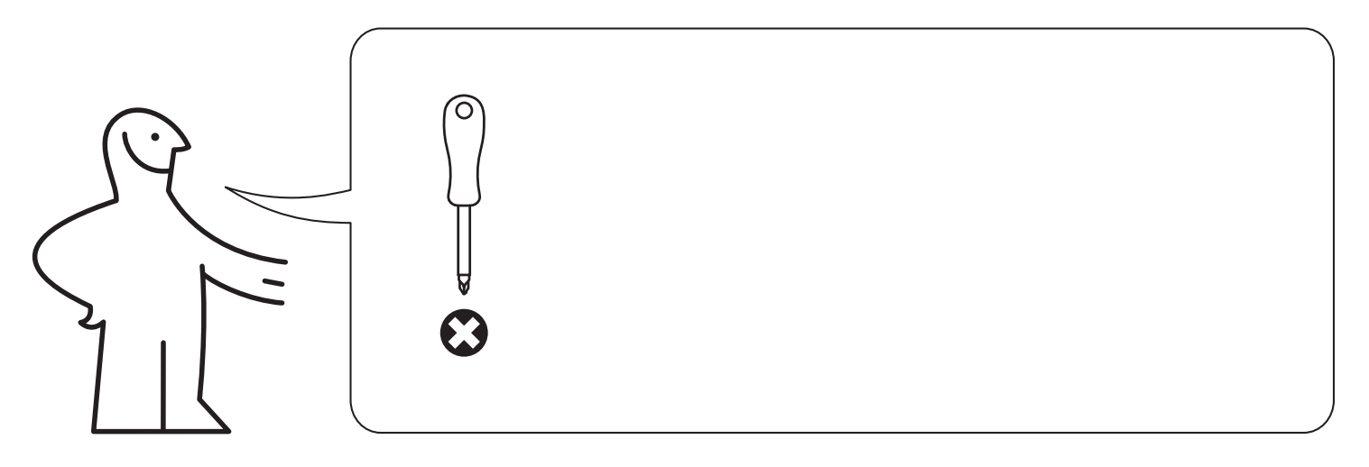
The build specification is how Python makes your library installable
Build: PEP 517 & 518

Slide 25
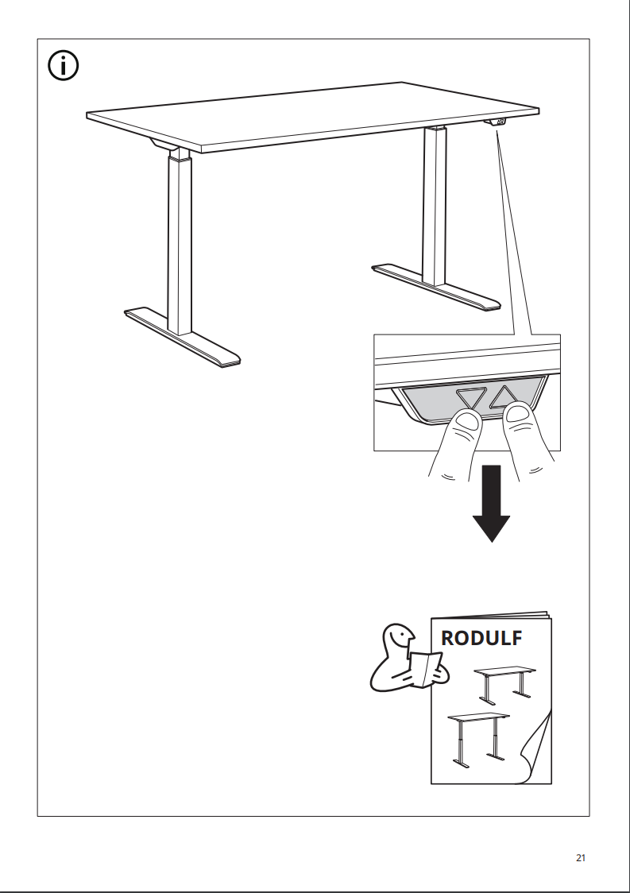
The project metadata contains information about the project itself
Build: PEP 517 & 518
Run: PEP 621

Slide 26


Most packaging tools have adopted these standards
Complicated
Few features
Many features
Poetry
Simple

Slide 27


After the standard, we also got new packaging tools that adhere to it
Complicated
Few features
Many features
Poetry
Hatch
Simple

Slide 28
Introduction and brief overview of packaging
✅
Comparison of packaging tools
✅
✅
“Live”
demo

Slide 29
All tools except poetry follows PEP 621
Feature | Hatch | PDM | Poetry | Flit | Setuptools
Follows PEP 621 | ✅ | ✅ | ✖ | ✅ | ✅
Supports C-extensions | ✅ (through plug-ins) | ✅ | ✅ (undocumented) | ✖ | ✅
Use other build-backends | ✖ | ✅ | ✖ | ✖ | ✖
Dependency management | ✖ | ✅ | ✅ | ✖ | ✖
Environment management | ✅🎉 | ✅ | ✅ | ✖ | ✖
Multiple developers | ✖ | ✖ | ✅ | ✖ | ✅
My favourite is PDM

Slide 30
All tools except Flit support building C-extensions
Feature | Hatch | PDM | Poetry | Flit | Setuptools
Follows PEP 621 | ✅ | ✅ | ✖ | ✅ | ✅
Supports C-extensions | ✅ (through plug-ins) | ✅ | ✅ (undocumented) | ✖ | ✅
Use other build-backends | ✖ | ✅ | ✖ | ✖ | ✖
Dependency management | ✖ | ✅ | ✅ | ✖ | ✖
Environment management | ✅🎉 | ✅ | ✅ | ✖ | ✖
Multiple developers | ✖ | ✖ | ✅ | ✖ | ✅
My favourite is PDM

Slide 31








PDM is the only tool that supports other build backends
Feature | Hatch | PDM | Poetry | Flit | Setuptools
Follows PEP 621 | ✅ | ✅ | ✖ | ✅ | ✅
Supports C-extensions | ✅ (through plug-ins) | ✅ | ✅ (undocumented) | ✖ | ✅
Use other build-backends | ✖ | ✅ | ✖ | ✖ | ✖
Dependency management | ✖ | ✅ | ✅ | ✖ | ✖
Environment management | ✅🎉 | ✅ | ✅ | ✖ | ✖
Multiple developers | ✖ | ✖ | ✅ | ✖ | ✅
Frontend
Backend
<

Slide 32


PDM is the only tool that supports other build backends
Feature | Hatch | PDM | Poetry | Flit | Setuptools
Follows PEP 621 | ✅ | ✅ | ✖ | ✅ | ✅
Supports C-extensions | ✅ (through plug-ins) | ✅ | ✅ (undocumented) | ✖ | ✅
Use other build-backends | ✖ | ✅ | ✖ | ✖ | ✖
Dependency management | ✖ | ✅ | ✅ | ✖ | ✖
Environment management | ✅🎉 | ✅ | ✅ | ✖ | ✖
Multiple developers | ✖ | ✖ | ✅ | ✖ | ✅
Frontend
Backend
<

Slide 33

PDM is the only tool that supports other build backends
Feature | Hatch | PDM | Poetry | Flit | Setuptools
Follows PEP 621 | ✅ | ✅ | ✖ | ✅ | ✅
Supports C-extensions | ✅ (through plug-ins) | ✅ | ✅ (undocumented) | ✖ | ✅
Use other build-backends | ✖ | ✅ | ✖ | ✖ | ✖
Dependency management | ✖ | ✅ | ✅ | ✖ | ✖
Environment management | ✅🎉 | ✅ | ✅ | ✖ | ✖
Multiple developers | ✖ | ✖ | ✅ | ✖ | ✅
Frontend
Backend
<

Slide 34
PDM and poetry both support managing your dependencies
Feature | Hatch | PDM | Poetry | Flit | Setuptools
Follows PEP 621 | ✅ | ✅ | ✖ | ✅ | ✅
Supports C-extensions | ✅ (through plug-ins) | ✅ | ✅ (undocumented) | ✖ | ✅
Use other build-backends | ✖ | ✅ | ✖ | ✖ | ✖
Dependency management | ✖ | ✅ | ✅ | ✖ | ✖
Environment management | ✅🎉 | ✅ | ✅ | ✖ | ✖
Multiple developers | ✖ | ✖ | ✅ | ✖ | ✅

Slide 35
Hatch excels at environment management
Feature | Hatch | PDM | Poetry | Flit | Setuptools
Follows PEP 621 | ✅ | ✅ | ✖ | ✅ | ✅
Supports C-extensions | ✅ (through plug-ins) | ✅ | ✅ (undocumented) | ✖ | ✅
Use other build-backends | ✖ | ✅ | ✖ | ✖ | ✖
Dependency management | ✖ | ✅ | ✅ | ✖ | ✖
Environment management | ✅🎉 | ✅ | ✅ | ✖ | ✖
Multiple developers | ✖ | ✖ | ✅ | ✖ | ✅

Slide 36
Hatch excels at environment management
Feature | Hatch | PDM | Poetry | Flit | Setuptools
Follows PEP 621 | ✅ | ✅ | ✖ | ✅ | ✅
Supports C-extensions | ✅ (through plug-ins) | ✅ | ✅ (undocumented) | ✖ | ✅
Use other build-backends | ✖ | ✅ | ✖ | ✖ | ✖
Dependency management | ✖ | ✅ | ✅ | ✖ | ✖
Environment management | ✅🎉 | ✅ | ✅ | ✖ | ✖
Multiple developers | ✖ | ✖ | ✅ | ✖ | ✅
[tool.hatch.envs.test.overrides]
matrix.auth.features = [
{ value = "oauth", if = ["oauth2"] },
{ value = "kerberos", if = ["krb5"] },
]
[[tool.hatch.envs.test.matrix]]
python = ["2.7", "3.8"]
auth = ["oauth2", "krb5", "noauth"]

Slide 37
Poetry and Setuptools are the only projects with more than one developer
Feature | Hatch | PDM | Poetry | Flit | Setuptools
Follows PEP 621 | ✅ | ✅ | ✖ | ✅ | ✅
Supports C-extensions | ✅ (through plug-ins) | ✅ | ✅ (undocumented) | ✖ | ✅
Use other build-backends | ✖ | ✅ | ✖ | ✖ | ✖
Dependency management | ✖ | ✅ | ✅ | ✖ | ✖
Environment management | ✅🎉 | ✅ | ✅ | ✖ | ✖
Multiple developers | ✖ | ✖ | ✅ | ✖ | ✅

Slide 38


Feature | Hatch | PDM | Poetry | Flit | Setuptools
Follows PEP 621 | ✅ | ✅ | ✖ | ✅ | ✅
Supports C-extensions | ✅ (through plug-ins) | ✅ | ✅ (undocumented) | ✖ | ✅
Use other build-backends | ✖ | ✅ | ✖ | ✖ | ✖
Dependency management | ✖ | ✅ | ✅ | ✖ | ✖
Environment management | ✅🎉 | ✅ | ✅ | ✖ | ✖
Multiple developers | ✖ | ✖ | ✅ | ✖ | ✅

Slide 39
Any of these tools will probably serve your packaging needs
Feature | Hatch | PDM | Poetry | Flit | Setuptools
Follows PEP 621 | ✅ | ✅ | ✖ | ✅ | ✅
Supports C-extensions | ✅ (through plug-ins) | ✅ | ✅ (undocumented) | ✖ | ✅
Use other build-backends | ✖ | ✅ | ✖ | ✖ | ✖
Dependency management | ✖ | ✅ | ✅ | ✖ | ✖
Environment management | ✅🎉 | ✅ | ✅ | ✖ | ✖
Multiple developers | ✖ | ✖ | ✅ | ✖ | ✅

Slide 40
Any of these tools will probably serve your packaging needs
Feature | Hatch | PDM | Poetry | Flit | Setuptools
Follows PEP 621 | ✅ | ✅ | ✖ | ✅ | ✅
Supports C-extensions | ✅ (through plug-ins) | ✅ | ✅ (undocumented) | ✖ | ✅
Use other build-backends | ✖ | ✅ | ✖ | ✖ | ✖
Dependency management | ✖ | ✅ | ✅ | ✖ | ✖
Environment management | ✅🎉 | ✅ | ✅ | ✖ | ✖
Multiple developers | ✖ | ✖ | ✅ | ✖ | ✅
Especially these tools

Slide 41

My favourite is PDM
Feature | Hatch | PDM | Poetry | Flit | Setuptools
Follows PEP 621 | ✅ | ✅ | ✖ | ✅ | ✅
Supports C-extensions | ✅ (through plug-ins) | ✅ | ✅ (undocumented) | ✖ | ✅
Use other build-backends | ✖ | ✅ | ✖ | ✖ | ✖
Dependency management | ✖ | ✅ | ✅ | ✖ | ✖
Environment management | ✅🎉 | ✅ | ✅ | ✖ | ✖
Multiple developers | ✖ | ✖ | ✅ | ✖ | ✅
Especially these tools

Slide 42
Introduction and brief overview of packaging
✅
Comparison of packaging tools
✅
✅
“Live”
demo

Slide 43
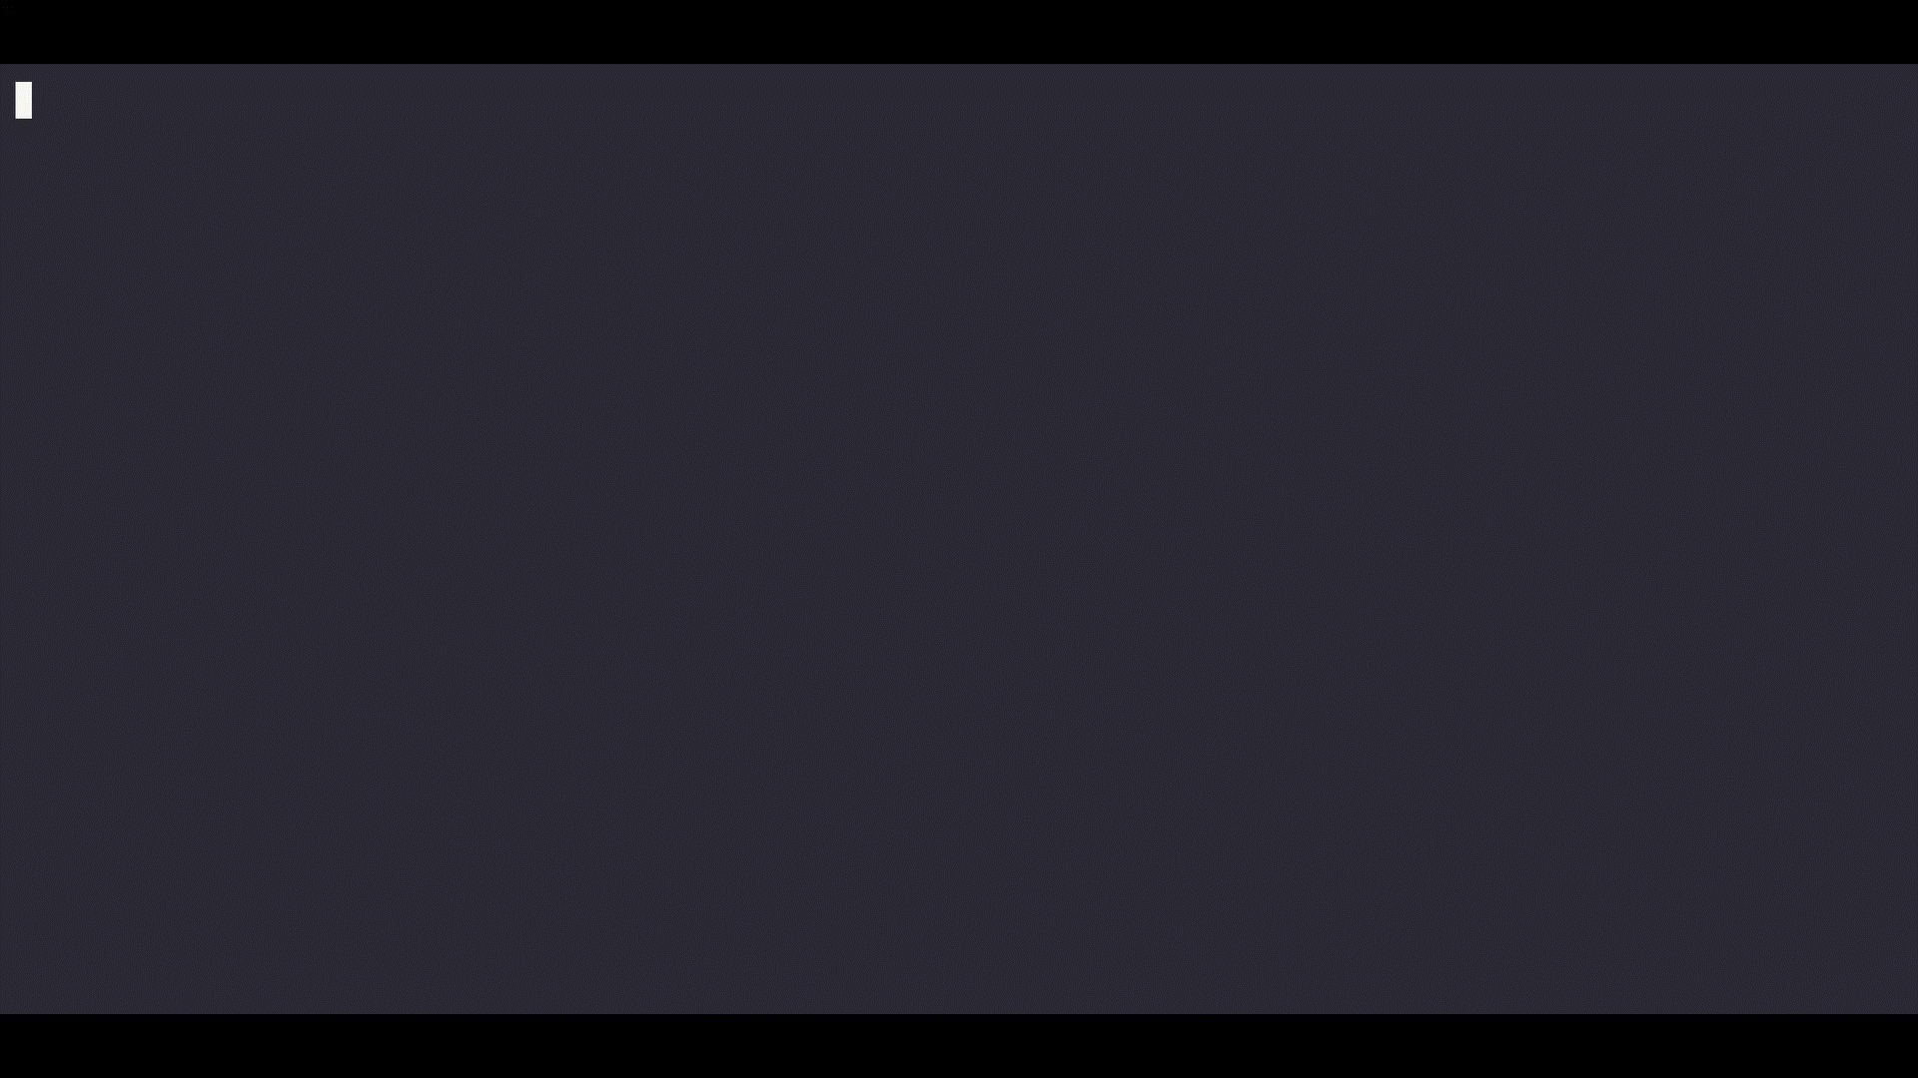

Slide 44
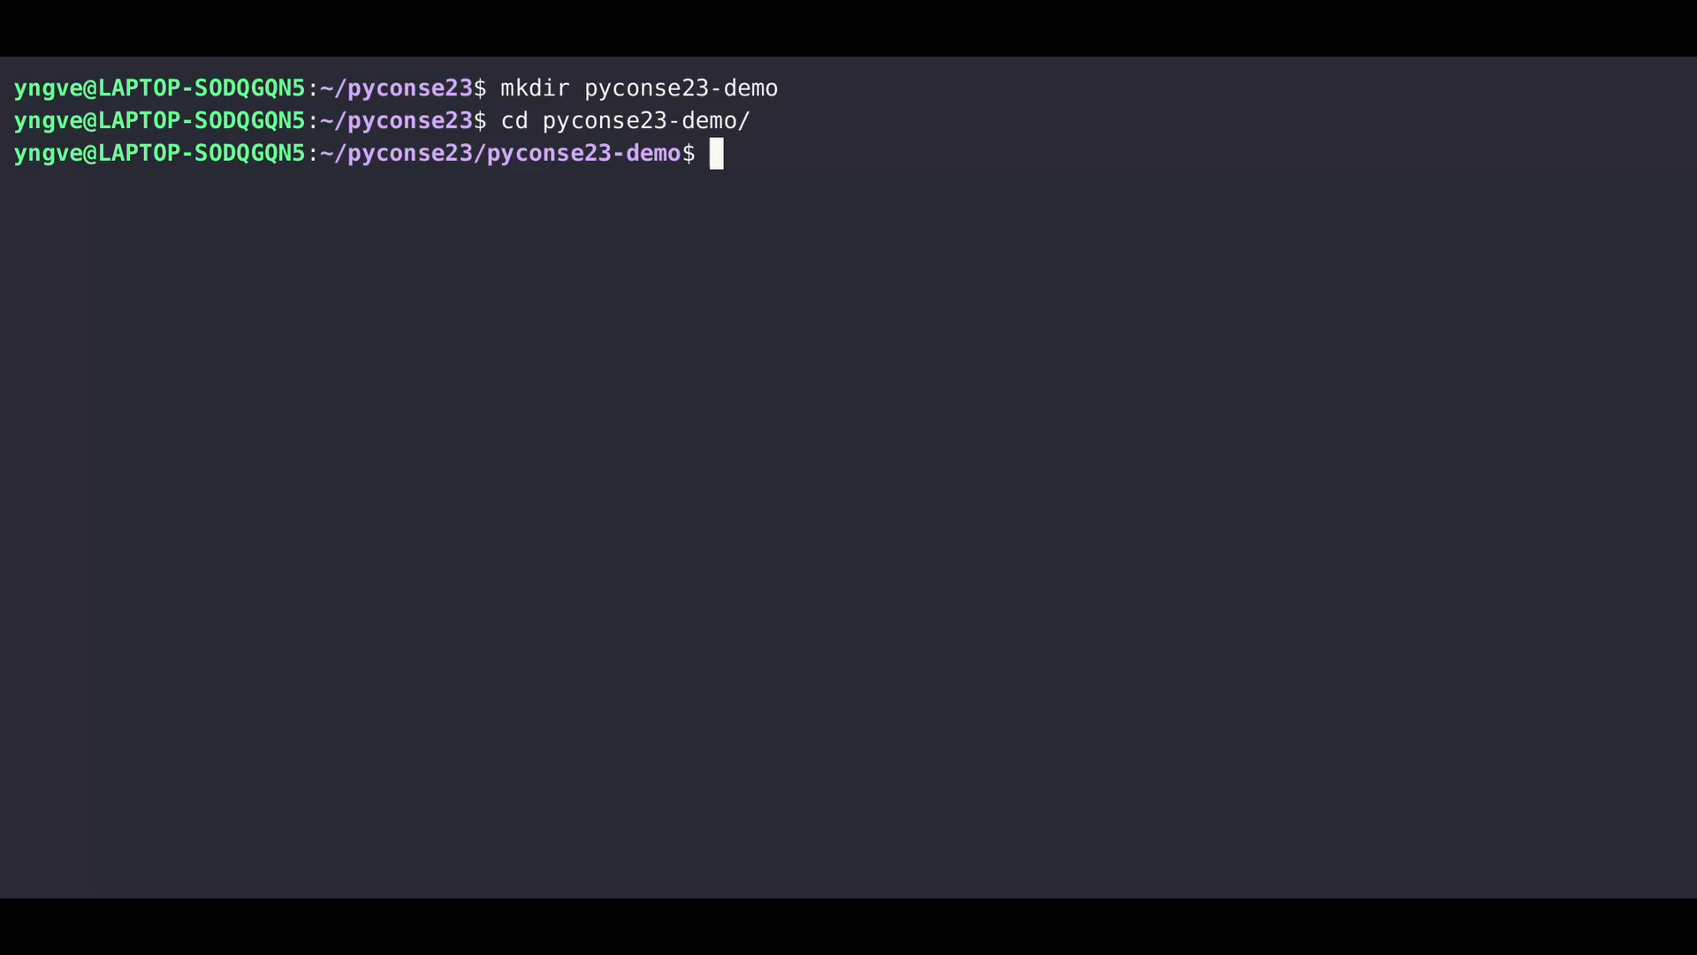

Slide 45
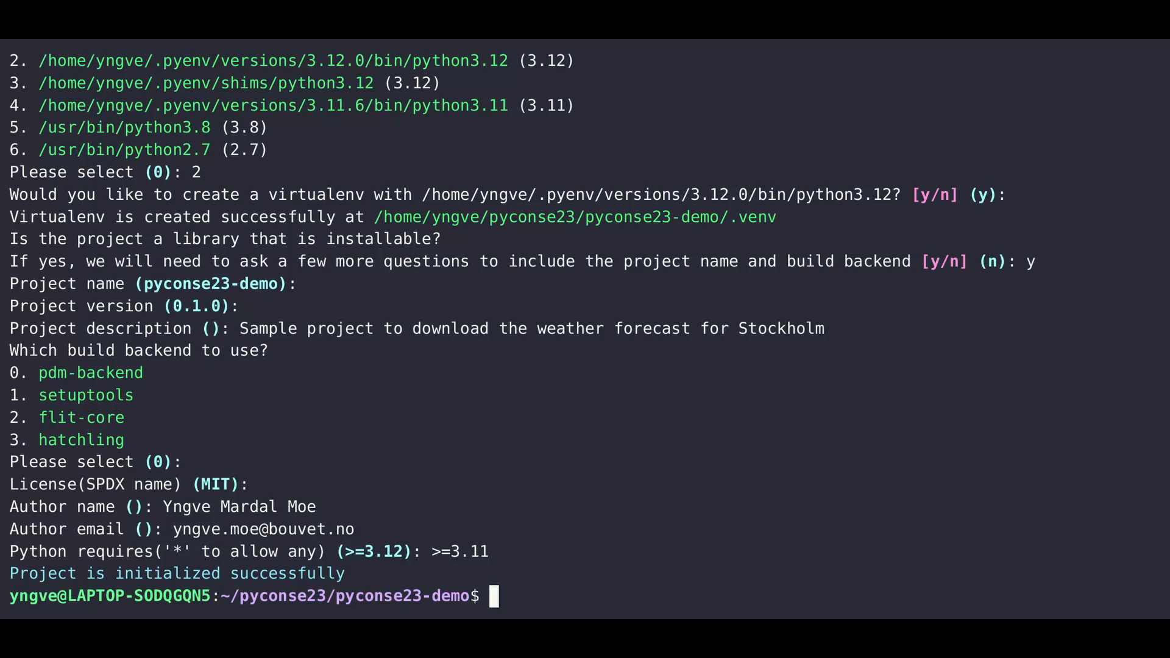

Slide 46
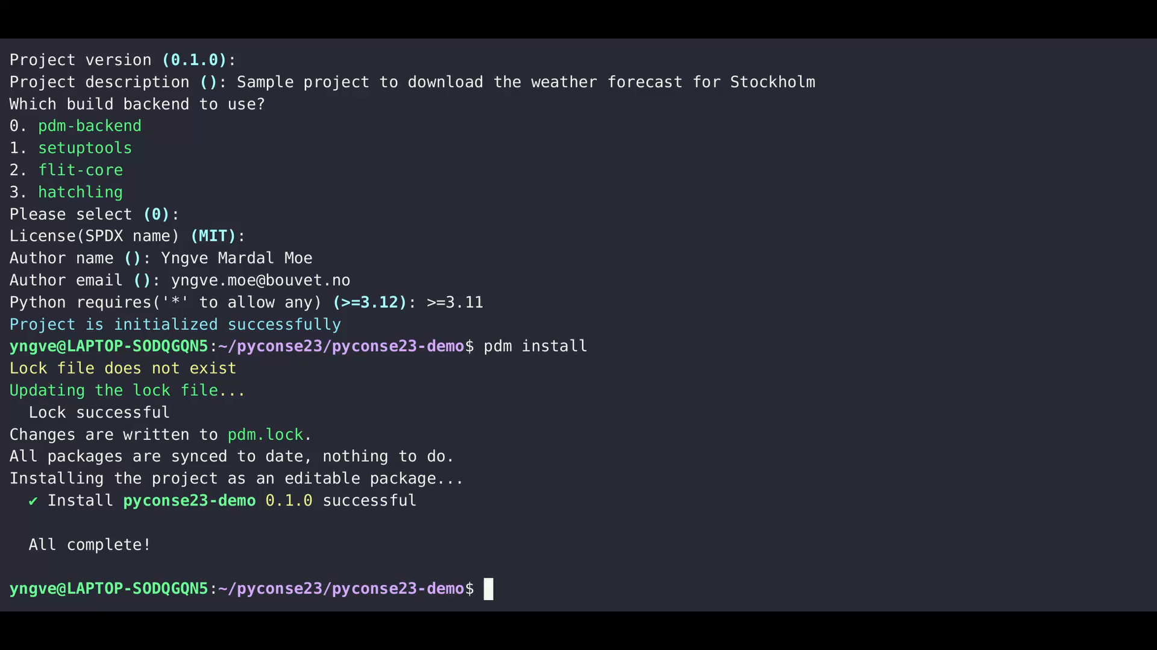

Slide 47
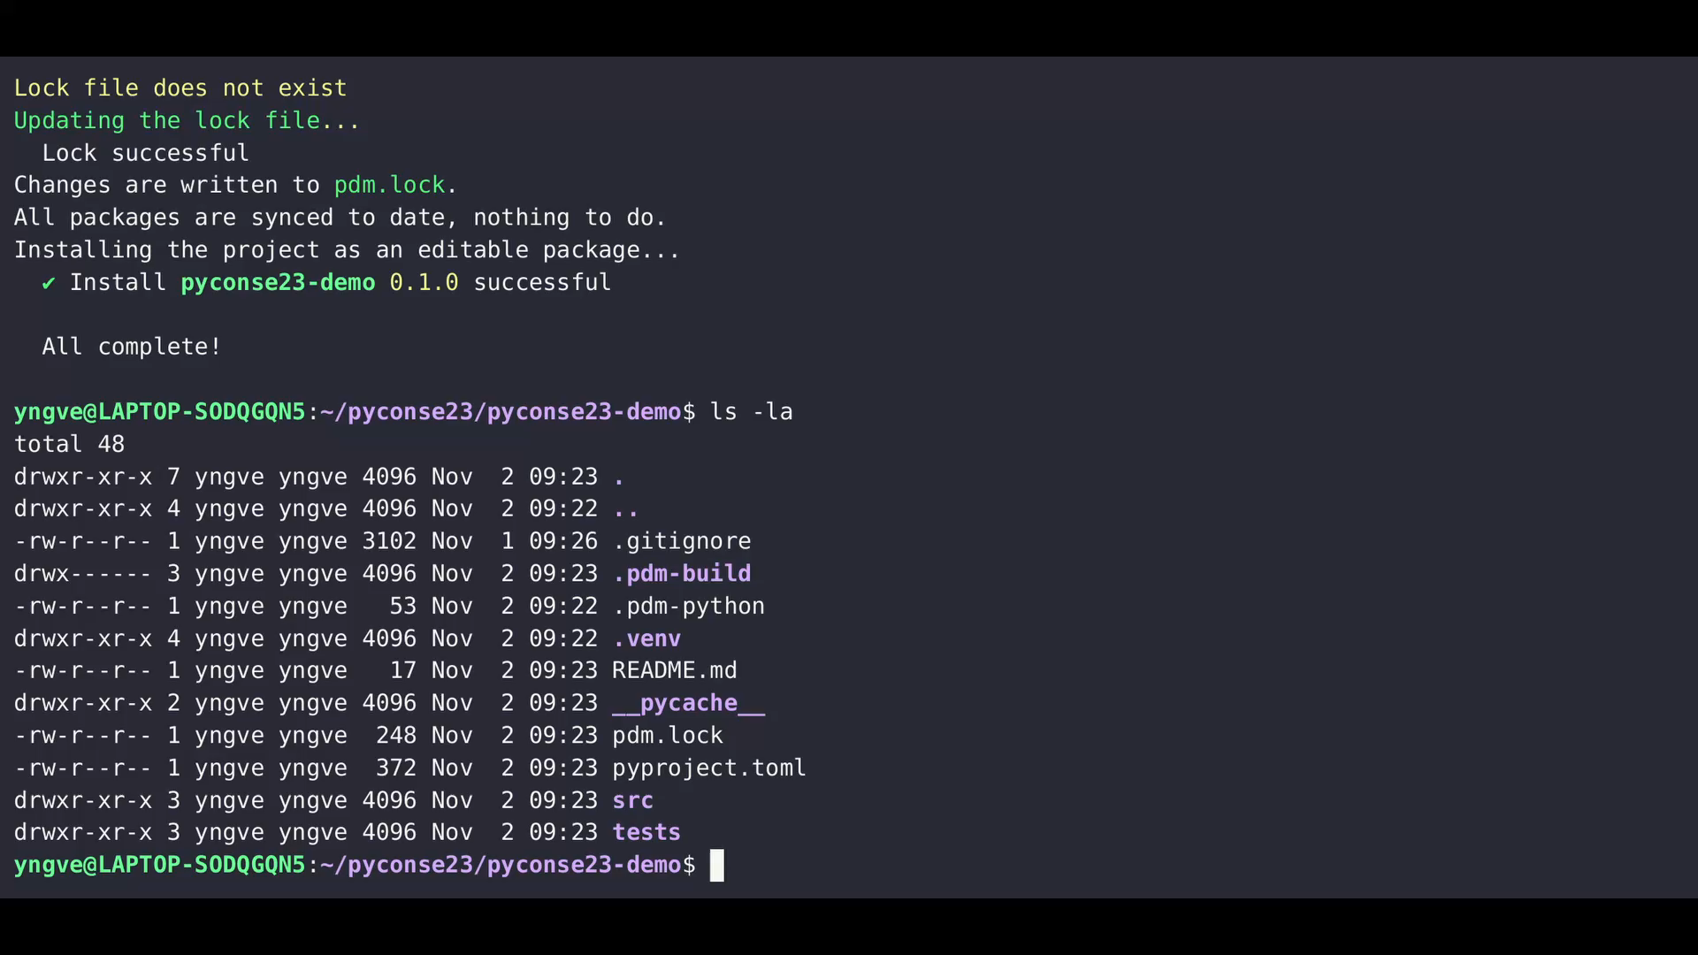

Slide 48
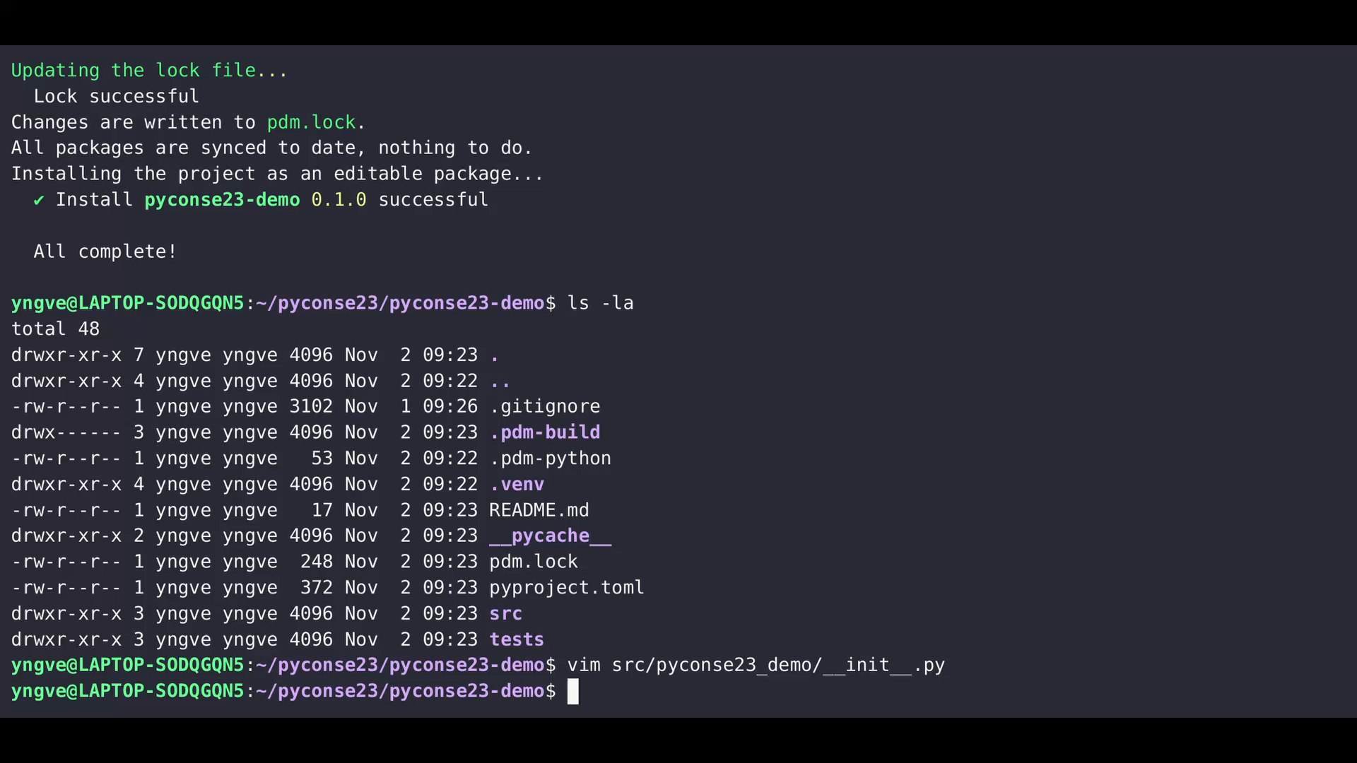

Slide 49
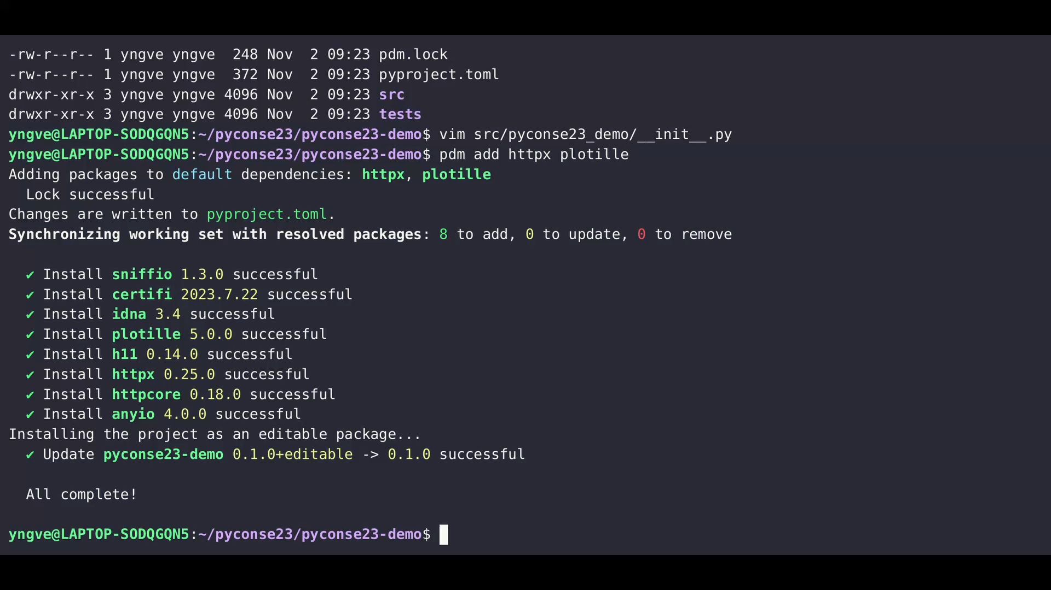

Slide 50
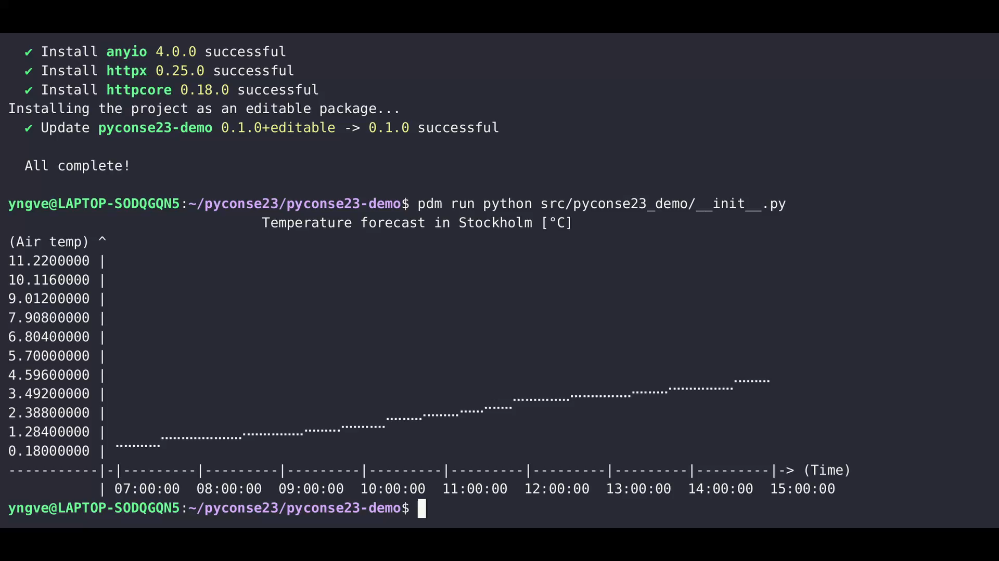

Slide 51
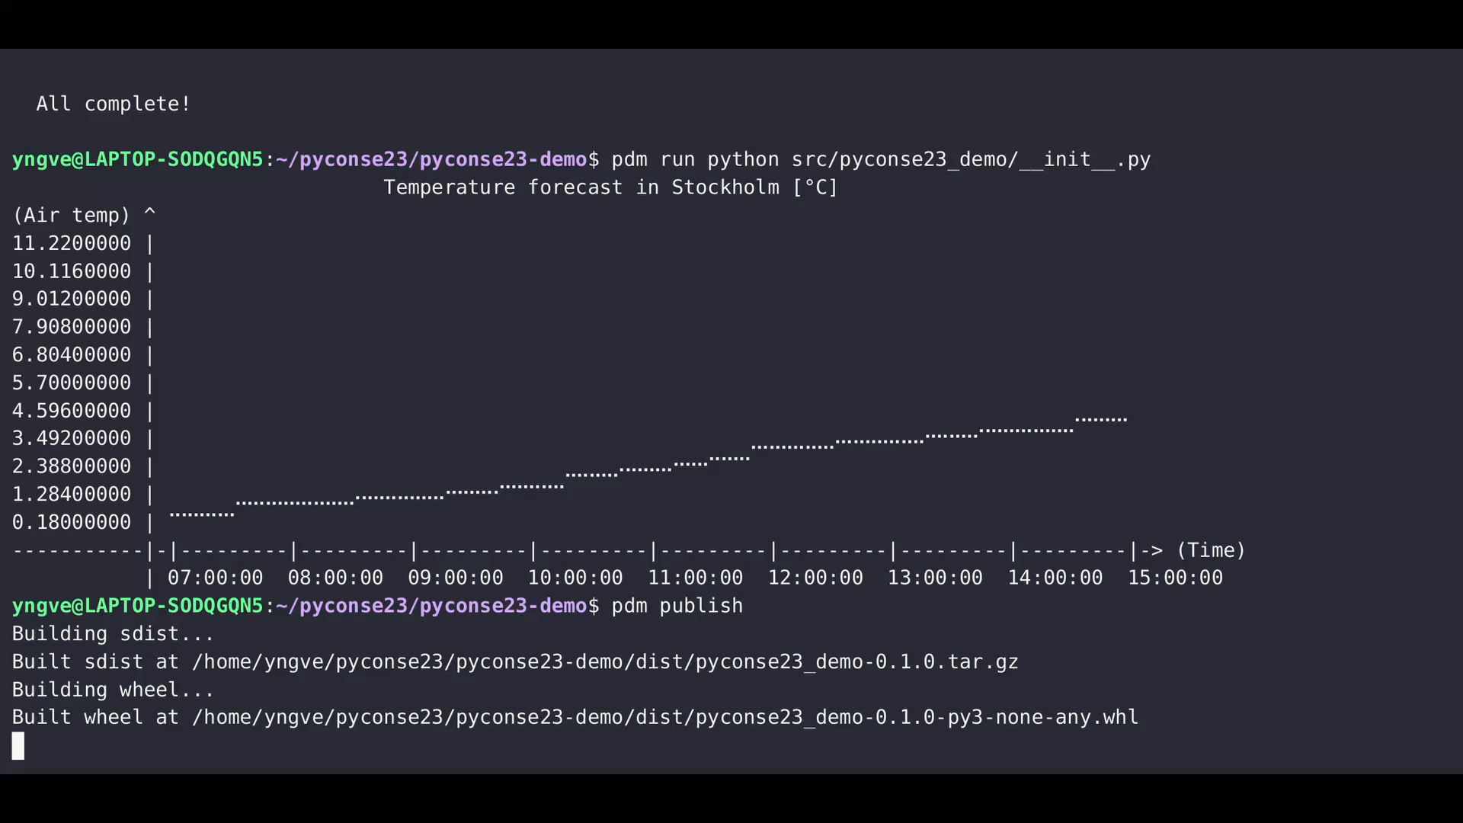

Slide 52
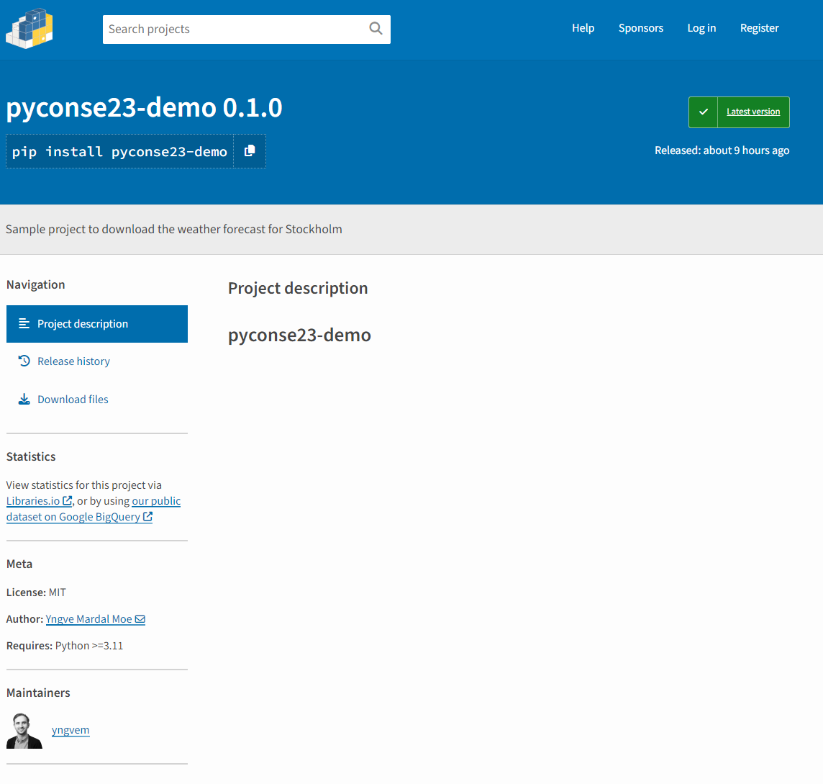
You can now pip install pyconse23-demo if you want to get the weather forecast for Stockholm!

Slide 53
These resources are great if you want to learn more about packaging
pyOpenSci Python Open Source Package Development Guide: https://www.pyopensci.org/python-package-guide/
Python Packaging User Guide: https://packaging.python.org/en/latest/
Declaring project metadata: https://packaging.python.org/en/latest/specifications/declaring-project-metadata/
Why SciPy builds for Python 3.12 on Windows are a minor miracle: https://labs.quansight.org/blog/building-scipy-with-flang
Various PEPs (somewhat in order of relevance):
How to store metadata in pyproject.toml files: PEP 621
Dependency specification: PEP 508
Build backend metadata and interfaces: PEP 517 & 518
The wheel standard: PEP 427
How metadata is stored in installed projects (in PKG-INFO files): PEP 345, 566 & 643

Slide 54
These resources are great if you want to learn more about packaging
pyOpenSci Python Open Source Package Development Guide: https://www.pyopensci.org/python-package-guide/
Python Packaging User Guide: https://packaging.python.org/en/latest/
Declaring project metadata: https://packaging.python.org/en/latest/specifications/declaring-project-metadata/
Why SciPy builds for Python 3.12 on Windows are a minor miracle: https://labs.quansight.org/blog/building-scipy-with-flang
Various PEPs (somewhat in order of relevance):
How to store metadata in pyproject.toml files: PEP 621
Dependency specification: PEP 508
Build backend metadata and interfaces: PEP 517 & 518
The wheel standard: PEP 427
How metadata is stored in installed projects (in PKG-INFO files): PEP 345, 566 & 643

Slide 55

These resources are great if you want to learn more about packaging
pyOpenSci Python Open Source Package Development Guide: https://www.pyopensci.org/python-package-guide/
Python Packaging User Guide: https://packaging.python.org/en/latest/
Declaring project metadata: https://packaging.python.org/en/latest/specifications/declaring-project-metadata/
Why SciPy builds for Python 3.12 on Windows are a minor miracle: https://labs.quansight.org/blog/building-scipy-with-flang
Various PEPs (somewhat in order of relevance):
How to store metadata in pyproject.toml files: PEP 621
Dependency specification: PEP 508
Build backend metadata and interfaces: PEP 517 & 518
The wheel standard: PEP 427
How metadata is stored in installed projects (in PKG-INFO files): PEP 345, 566 & 643

Slide 56
To summarise, packaging is the task of preparing your code to be easily used by others, and PDM makes packaging easy
<

Slide 57
To summarise, packaging is the task of preparing your code to be easily used by others, and PDM makes packaging easy
<
Questions?

